Slide 1

PARISH SURVEY RESULTS
Responses collected at Masses 15th & 16th May 2021
St. John Vianney – West Green

Slide 2
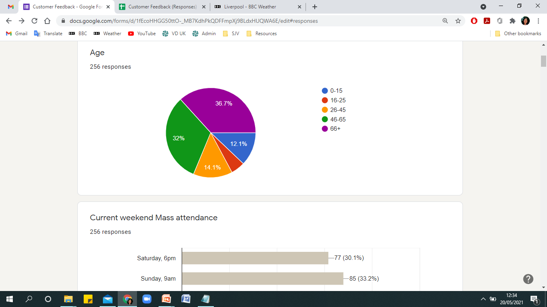
AGE OF PARTICIPANTS (256 TOTAL)

Slide 3
VACCINATION STATUS
AGE | FULL (2 JABS) | PARTIAL (1 JAB) | WAITING | NO INTENTION TO BE VACCINATED
ALL | 133 (52%) | 52 (20%) | 46 (18%) | 25 (10%)
0-15 |  |  | 17 | 14
16-25 | 2 |  | 9 | 2
26-45 | 6 | 11 | 15 | 4
46-65 | 40 | 33 | 4 | 5
66+ | 85 | 8 | 1

Slide 4
HOW HAVE THE LAST 15 MONTHS AFFECTED YOU?
It didn’t affect me much at all | 132
I struggled with my studies | 23
I lost a job | 10 | 9 found new jobs; 1 still unemployed
I lost a loved one | 45 | 19 attended the funeral in person; 12 attended online; 14 were unable to attend at all
I struggled with mental health/loneliness | 36 | → 9 were unable to find support
My physical health has been affected | 32
Other | 27 | → Struggled with homeschooling children / working from home; wedding was postponed; caring for sick person; unable to see family/friends; other not specified

Slide 5
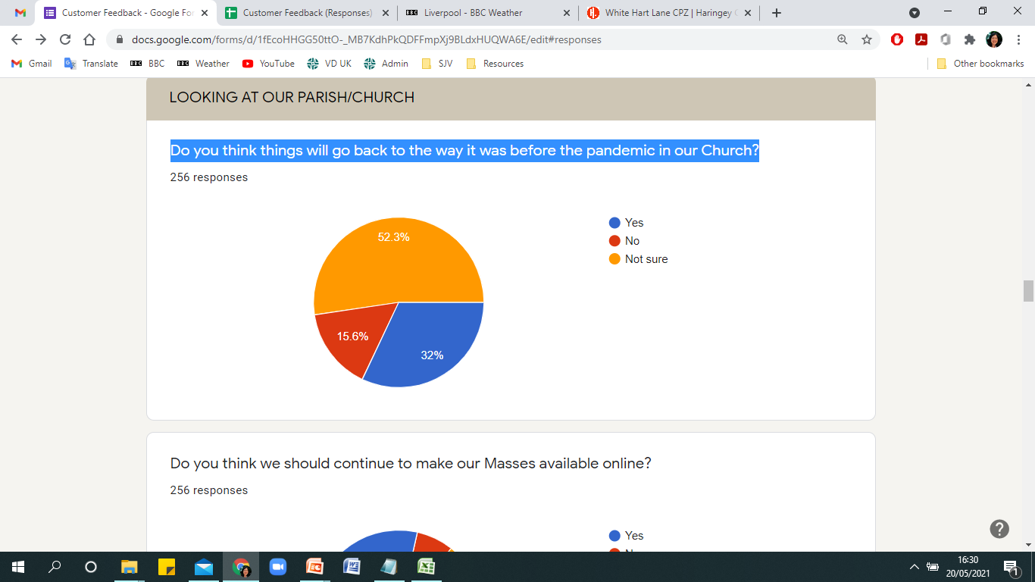
DO YOU THINK THINGS WILL GO BACK TO THE WAY IT WAS BEFORE THE PANDEMIC IN OUR CHURCH?

Slide 6
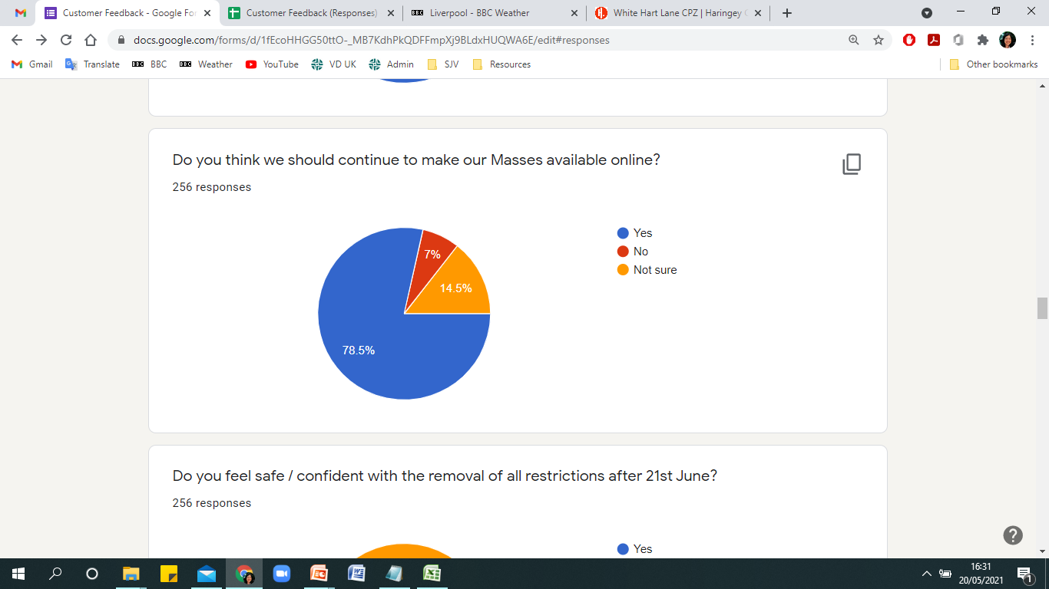
DO YOU THINK WE SHOULD CONTINUE TO MAKE OUR MASSES AVAILABLE ONLINE?

Slide 7
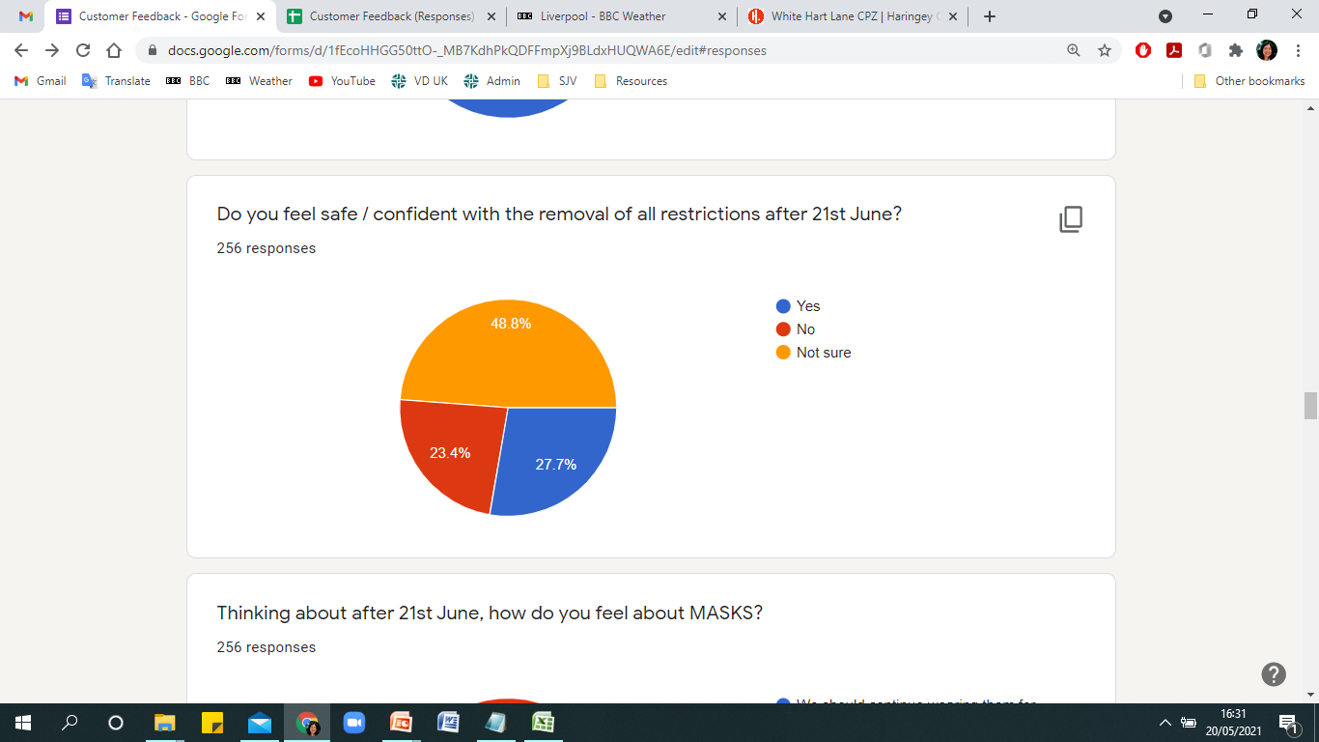
DO YOU FEEL SAFE/CONFIDENT WITH THE REMOVAL OF ALL RESTRICTIONS ON 21ST JUNE?
* Note that, out of the 70 people who answered ‘YES’:
31 of these still feel the need to continue wearing masks/hand sanitising;
30 prefers not to do so but are happy to continue the practice if required

Slide 8
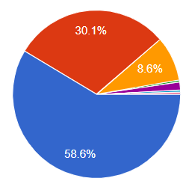
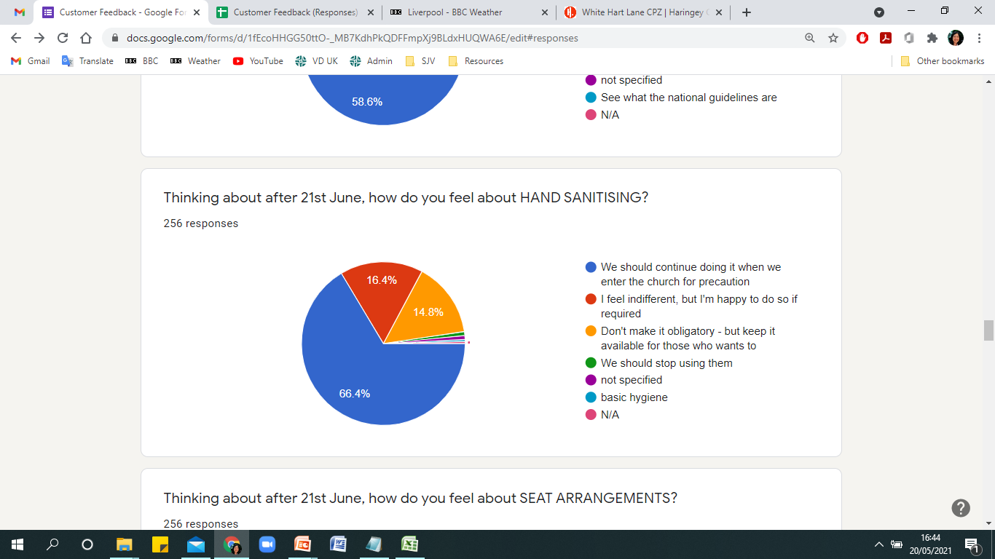
THINKING ABOUT AFTER 21st JUNE, HOW DO YOU FEEL ABOUT MASKS?
We should continue wearing them for precaution
I prefer not to wear them, but I’m happy to do so if required
Don’t make it obligatory – let each person choose
We should stop using them
Other responses

Slide 9
THINKING ABOUT AFTER 21st JUNE, HOW DO YOU FEEL ABOUT HAND SANITISING?
We should continue doing it for precaution
I feel indifferent, but I’m happy to do so if required
Don’t make it obligatory – but keep it available for use
We should stop using them
Other responses

Slide 10
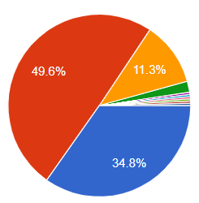
THINKING ABOUT AFTER 21st JUNE, HOW DO YOU FEEL ABOUT SEATING ARRANGEMENT?
Don’t change the set up – I feel safe with the current arrangement
We can reduce the spacing slightly to increase our church capacity
Go back to how things were before, and remove all restrictions
Other responses

Slide 11
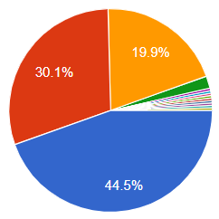
THINKING ABOUT AFTER 21st JUNE, HOW DO YOU FEEL ABOUT REFRESHMENT IN THE HALL?
Unsure / I feel indifferent
I would like it to resume as soon
as possible
We should wait a bit longer
Other (variants of the above three answers)

Slide 12
Thinking of the last 15 months, what might be some of the POSITIVE things that you experienced / learned / discovered about YOURSELF?
Selected answers (some of these appeared repeatedly in similar words):
“Resilience and patience and I have also learnt to slow down”
“I'm happier with my own company than I thought I'd be”
“More aware of people's needs - selfless people around”
“Faith is very important in difficult times”
“I appreciate more the value of family, friends, mutual support/appreciate more the gift of life”
“Able to adapt to what is needed. Learnt new skills (e.g. re. I.T. and working by phone etc)”
“I prayed & meditated a lot.”
“I'm adaptable and coped well with the changes. I realised how much I value coming to church to reflect and just be.”
“I rediscovered God in the last few months”

Slide 13
Thinking of the last 15 months, what might be some of the POSITIVE things that you experienced / learned / discovered about THE CHURCH?
Selected answers (some of these appeared repeatedly in similar words):
“The community and the congregation are selfless and are incredibly committed to providing top notch service. Great consideration for the publics health and safety and well being during the pandemic.”
“The Parish Team did a great job of providing Parishioners with the opportunity of regularly attending Mass, both virtually and in person.”
“How organised and up to date. Measures put in are brilliant.”
“Good at adapting”
“This kept me going. Our church is very helpful especially for lonely isolated people. Prayers and getting together helps a lot”
“The willingness to use online methods to help connect with the parish. The ongoing support for all who value the parish church so much”
“People actually care more than I thought”

Slide 14
What kind of Church would you like to see post-pandemic?
Selected answers (some of these appeared repeatedly in similar words):
“I would like to see our Church come together in an even more prayerful way. A men-only prayer group would be helpful.”
“Less formality/ more open to joining other local churches {different denominations) for prayer groups, reflection time, care of those in need, musical events, which in STJV could make use of the screen to show music performed by Christian performers like Matt Redmond and other great artists. The Eucharist is important but we really need to look at different ways to attract a more youthful participation. One thing very evident from Covid is that the church is kept going by us oldies!!”
“Targeted at younger people”
“The same as it was before pandemic”
“More varied (e.g. in celebrating sacrament of reconciliation as in pandemic). Involvement of the youth when possible.”

Slide 15
What is your deepest wish for our Parish community?
Selected answers (some of these appeared repeatedly in similar words):
“To get back to as much normality as possible”
“To continue to retain the strong community spirit and friendliness that exists in the Parish”
“That it remains vibrant and welcoming.”
“For it to be safe”
“Continue as they are”
“To keep going - not loose what we have”
“To keep the good work and welcome all new member. Have a youth group in the church or a mass with young people, and some meeting with young people.”
“To grow in faith. More faith study for adults. More dedicated. For people to stand up for their faith.”

